Slide 1
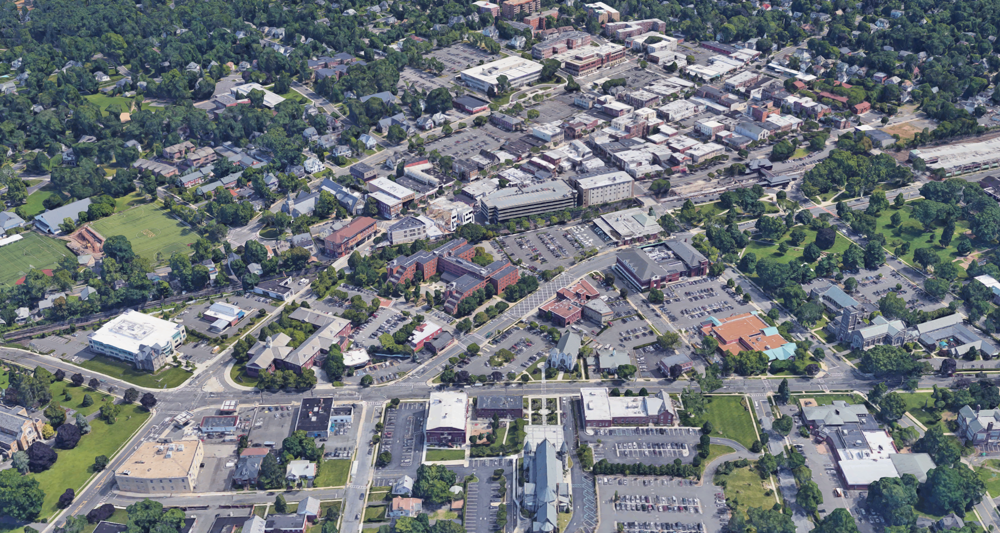
Broad Street West Redevelopment
Subdistrict 3 Presentation
Prepared by Topology
February 09, 2022
For The City of Summit

Slide 2
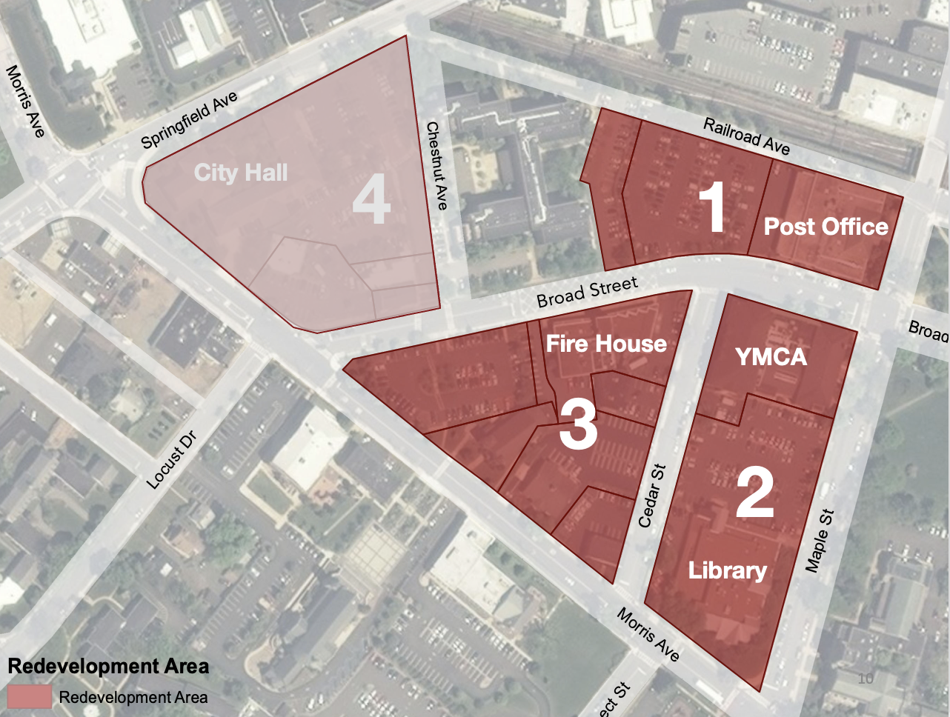
Project Area
Project Area
Redevelopment Area Project Area
2021 Tax Revenue: $135,584.02 2021 Tax Revenue: $29,994.52
Municipal Share: $27,135.65 Municipal Share: $6,000.07

Slide 3
Vision for Broad Street West
Create a new source for patrons to support the City’s well-loved downtown.
Provide a variety of appropriately-scaled infill transit-oriented development housing options near the City’s NJ Transit commuter station.
Offset the relocation costs of the firehouse to a modern facility that meets the current needs of the City.
Generate new sources of public revenues through the reuse of large parking lots owned by the City.

Slide 4
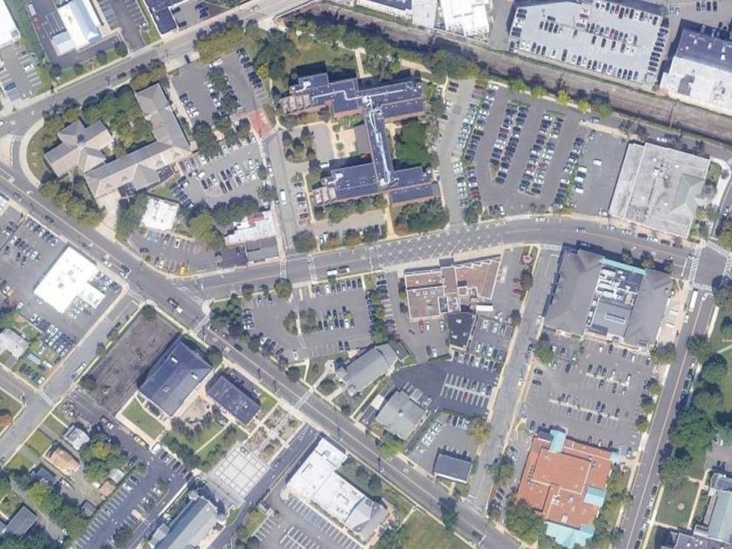
Vision for Subdistrict 3
A hub for this new neighborhood adjacent to an active downtown that provides experiences not currently available and complements the existing built environment and downtown.

Slide 5
Redevelopment Planning Timeline
2016: Master Plan Re-examination identified area to be considered for redevelopment.
2017: The Broad Street West Area is declared an “area in need of redevelopment” following a preliminary investigation.
2018: Considerable public outreach to create a redevelopment plan.
2019: Continued public outreach and sessions with existing property owners to refine redevelopment plan parameters.
2019: Adoption of Redevelopment Plan by Common Council after Planning Board review.

Slide 6
Redevelopment Planning Timeline
2018/19: City solicited proposals and vetted interested redevelopers
Dec 2019: City designated Broad Street West Managers I LLC; a partnership of L+M and Toll Brothers.
2020: Steering Committee worked directly with designated developer on concept plans.
May 2021: Public presentation of draft concept
2021: Steering Committee worked with stakeholders + experts to refine concept plans based on public feedback.

Slide 7
Today’s Objectives
Updated Project Numbers
Building Design (redeveloper)
Open Space Design (redeveloper)
Traffic Impacts (redeveloper)

Slide 8
Project Numbers
140 Units (112 Market, 21 COAH, 7 Workforce)
196 Parking Spaces Required
$8m Purchase Price for City Land
30 Year PILOT
$1.75m Redevelopment Area Bond
27 Projected Public School Aged Children

Slide 9
School Impacts
The information has been developed by Community Data Analytics (CDA): a unit of Econsult Solutions, Inc., a Philadelphia-based consulting company providing economic study services derived from the 5-year American Community Survey Public Use Microdata Sample (ACS-PUMS). These records are released every year, enabling CDA to update multipliers each year.
Any unexpected impacts on schools will be addressed directly with the Board of Education on an annual basis.

Slide 10
Potential Next Steps
February 15, 2022: Potential resolution by Common Council to execute a Letter of Interest consistent with the information presented today.
March 2022: Info session re: PILOTs
April 2022: Public hearing re: redevelopment agreement; potential introduction of financial agreement.
May 2022: Potential adoption of financial agreement.
June 2022: Earliest possible Planning Board Site Plan application.

Slide 11
The Redevelopment Team will now present their concept plans + traffic study findings.

