Slide 1
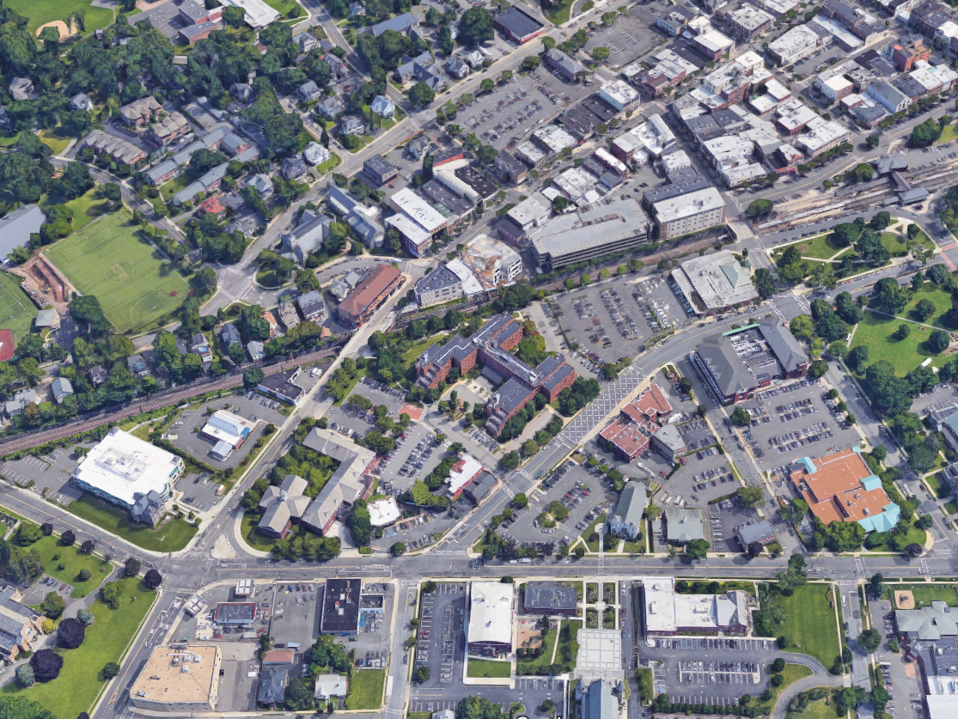
Broad Street West
Outreach + RFQ Update
May 31, 2018
PREPARED BY TOPOLOGY FOR THE CITY OF SUMMIT

Slide 2

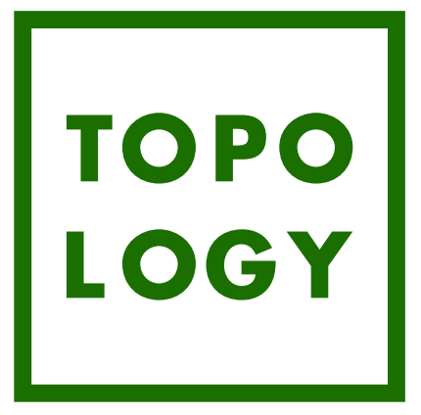
AGENDA
1
Introduction
2
Redevelopment Process
3
Community Outreach Findings
4
RFQ Details + Process

Slide 3
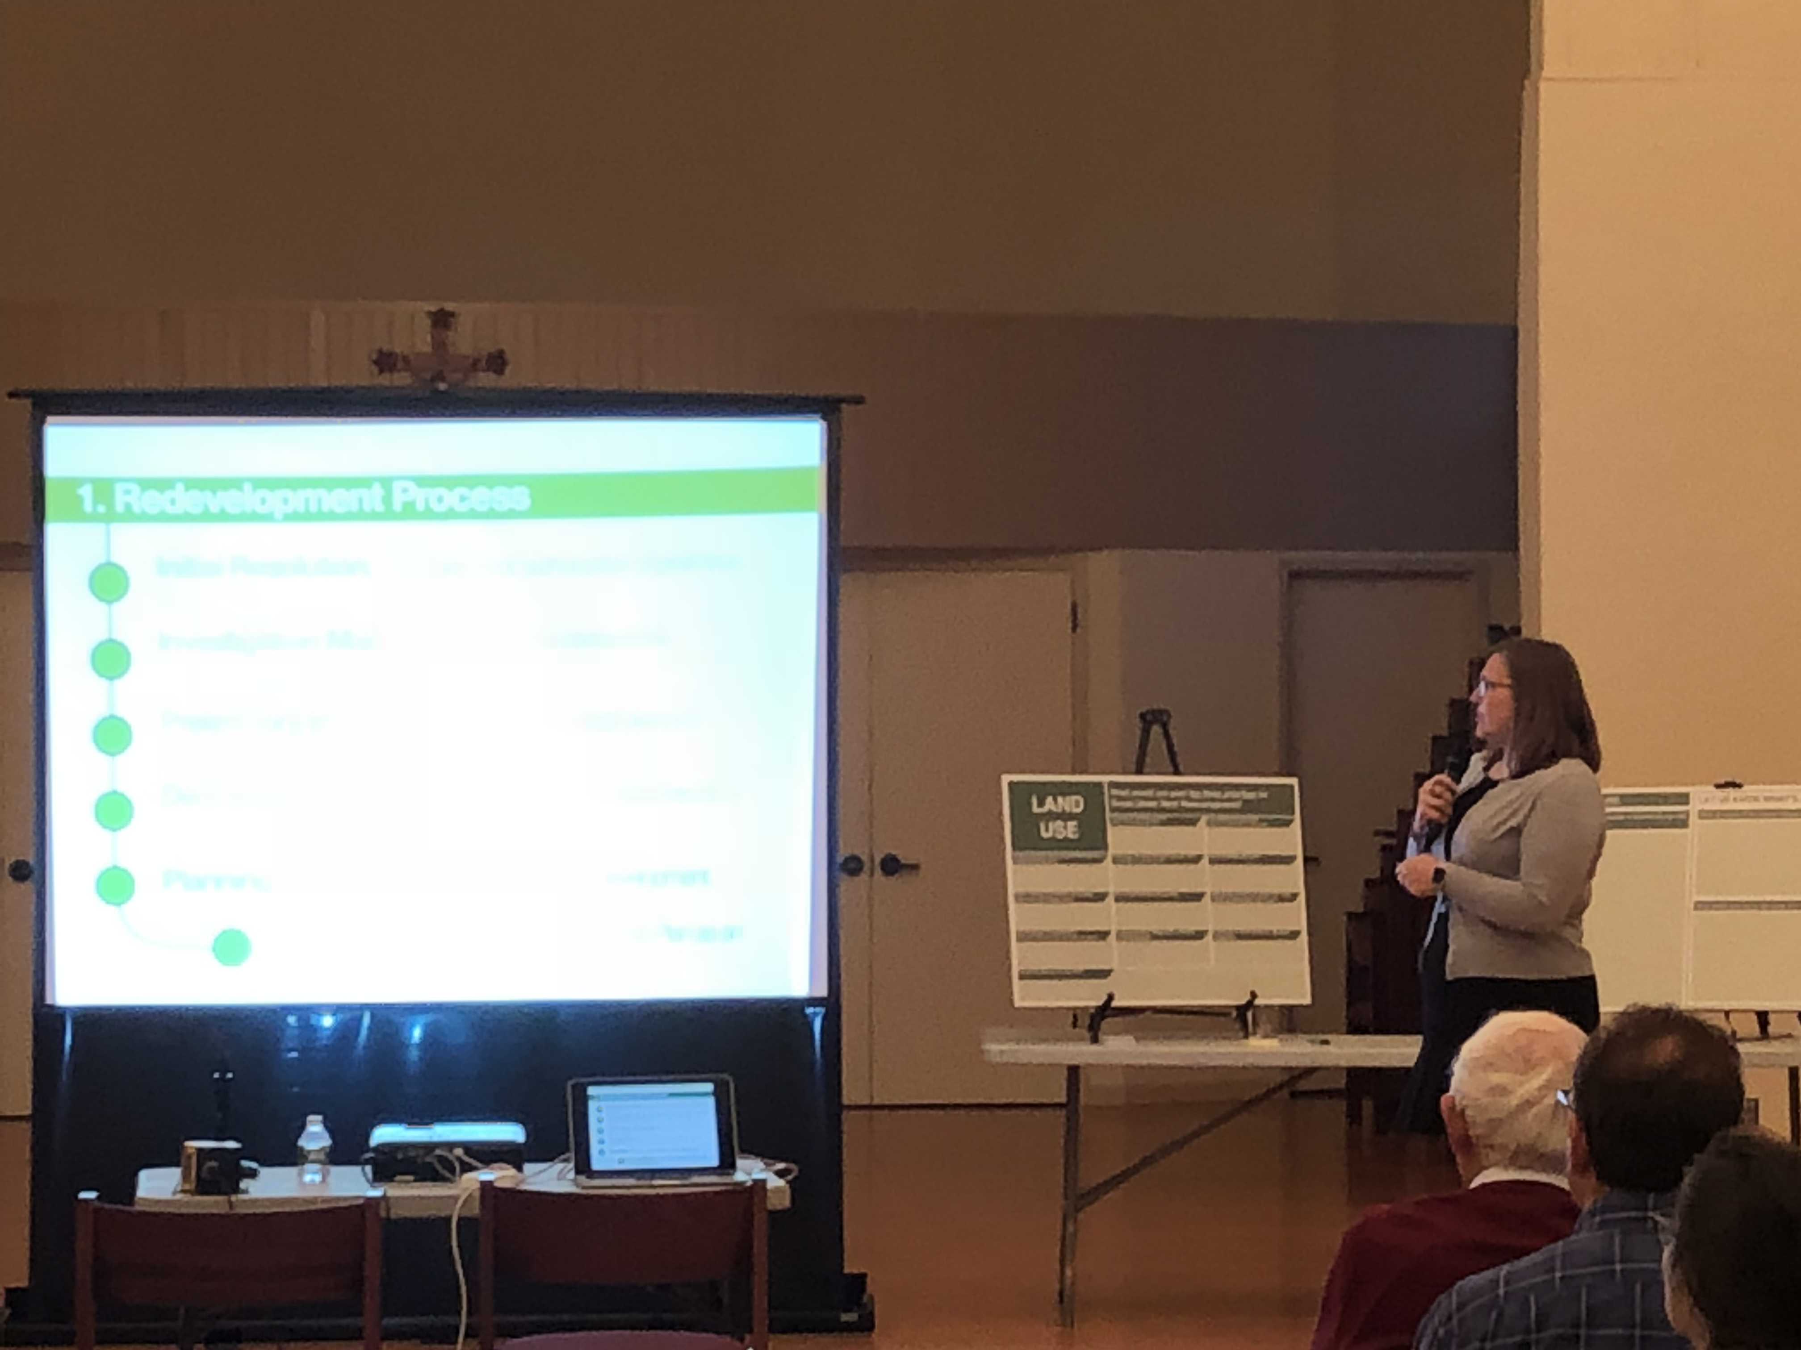
1. INTRODUCTION
Topology
City Redevelopment Planner
Managing the Planning Process tailored to Summit’s needs and objectives

Slide 4
1. INTRODUCTION
Non-condemnation area
No plans for any business/building to be relocated or closed
No developers have been consulted to date
No decisions have been made to date
Community-driven process tested by the market response—Request for Qualifications (RFQ)
Goal: Create ratables without burdening existing residents while finding opportunities to support the existing downtown.

Slide 5
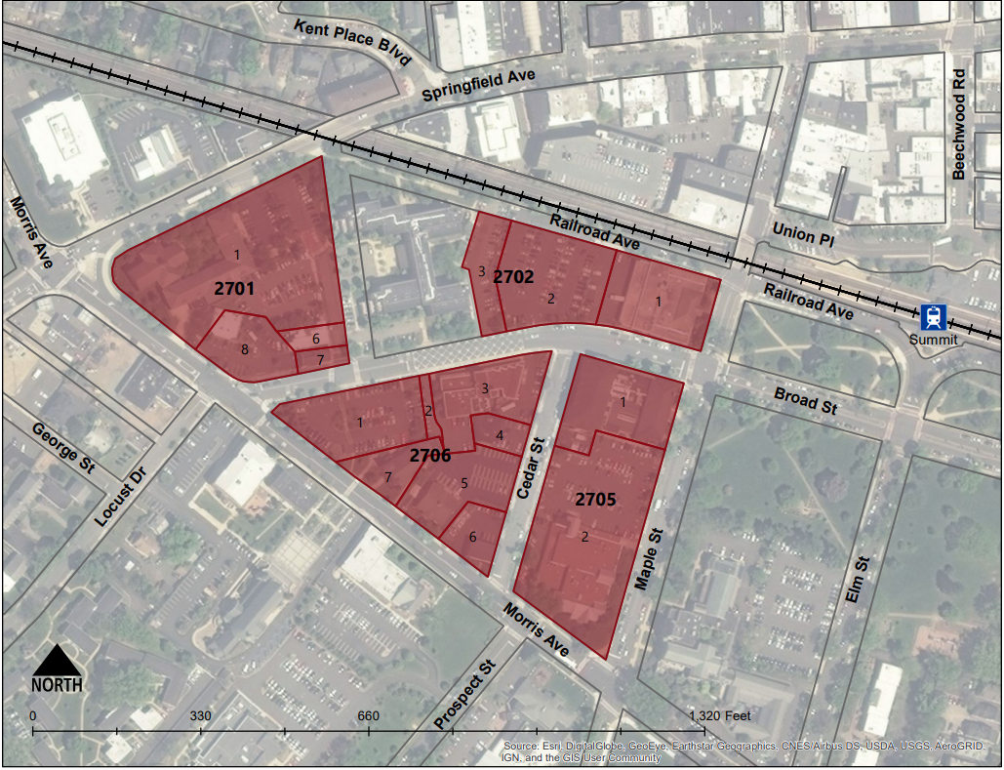
1. DESIGNATED REDEVELOPMENT AREA
14 Lots
10.07 Acres
6.3 Acres City Owned
11 Owners
$10,480,500 Assessed

Slide 6
2. REDEVELOPMENT PROCESS
Initial Resolution: Governing body directs Planning Board to undertake study – May 2, 2017
Investigation Map: Delineates the boundaries of the proposed redevelopment area
Preliminary Investigation: Analysis of study area and recommended course of action – September 15, 2017
Designation: Governing body resolution designating the redevelopment area adopted - November 13, 2017
Planning: Policy and regulatory framework for redevelopment.
Plan Adoption: Ordinance adopting the Plan as an amendment to Zoning

Slide 7
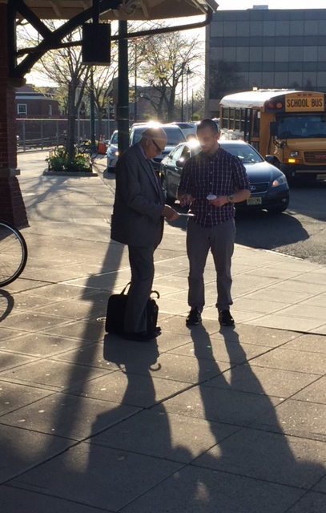
3. OUTREACH PROCESS
Public Forum: March 2018
City-wide Surveys: Spring 2018
Stakeholder Meetings: April 2018
High School Outreach: April 2018
Train Station Table: May 2018

Slide 8
3. PUBLIC FORUM
Major concern:
Congestion + movement in/around downtown
Pedestrian experience (Safety, Mobility)
Safe railroad crossings
Parking supply + location
Complimenting existing downtown
Demand for:
Entertainment Options
Evening activities (Bars, Dining, Movie Theater)
Options for teens and children
Seasonal Events, Music and Festivals
Diverse Range of Housing Options
Notes:
It should be emphasized that there was an overwhelming show of support across all ages, and every outreach method for the presence of a movie theater specifically. Entertainment for teens was also very frequently cited as a desire for the City.

Slide 9
3. CITY-WIDE SURVEYS
Public Spaces
+40% prefer landscaped public spaces; more seating
+60% desire more events + outdoor markets
Classic architectural styles
Solar panels on parking structures
Public gathering places
Expanded library + YMCA
Retail
Grocery store, movie theater
Morristown, Westfield + Berkeley Heights
Notes:
Also an expressed appreciation for and desired expansion of Library/YMCA programming in enhanced public spaces. Emphasizes the City’s need to streamline their event’s permission process as expressed at the City Hall meetings

Slide 10
3. STAKEHOLDER MEETINGS
Difficulties with parking
Opportunities for parking structures
Traffic: Broad Street + Morris Avenue
Market concerns re: housing + retail
Flexible outdoor space Library + YMCA
Property owners: better pedestrian connections to train station + downtown
Notes:
Local market concerns pertain specifically to lack of affordable housing options and a desire for a grocery store and family entertainment
Parking problems seem to be episodic corresponding to peak times at YMCA and events on village green

Slide 11
3. HIGH SCHOOL OUTREACH
Major Themes:
Pedestrian experience + safety
Green design + sustainability
Open space amenities
Dog parks
Skatepark
Seating + gathering places
More entertainment and nightlife
Events + Festivals
Movie Theater
Arcade
Diversity of retail options

Slide 12
3. PURPOSE OF PUBLIC OUTREACH
Public Outreach
RFQ
Redevelopment
Plan

Slide 13
4. WHAT IS A RFQ
Request for Qualifications
Non-binding
Preliminary step
Testing Marketability
Vet potential developers
Understand development parameters

Slide 14
4. RFQ OUTLINE
Project Snapshot
Introduction
The Redevelopment Area
Precedents
Developer + Developer Team Selection
Submittal Requirements
RFQ Due Date/Selection Process Schedule
Other Information
Notes:
Introduction
Explanation of what is needed by City
Context of City’s need
Summit’s population and characteristics
Neighborhood context
Master Plan excerpts
The Redevelopment Area
Specific details about the designated Area in Need of Redevelopment
Legal underpinnings of the redevelopment process
Blocks, lots + Ownership
Comments regarding City owned property

Slide 15
4. RFQ DETAILS
Project Snapshot
General site characteristics
Required Parking
RSIS + 262 existing + Addt’l Public
Type of Development
Mid-rise, mixed use, to include:
Structured parking, residential, commercial/retail + public space
Buried utilities
Temporary parking provisions
Notes:
NJRSIS parking requirements may be negotiated and amended in redevelopment plan based upon parking study to be funded by developer. 262 parking spots must be replaced within Redevelopment area. Additional parking 457 spaces for commuters and patrons to Redev area users desired, preferably under City control.
Building height to be consistent with existing City zoning
Affordable Housing requirements

Slide 16
4. RFQ DETAILS
Core Principles for Proposals
Incorporate Civic Engagement
Pedestrian-Friendly Streets
Car Circulation + Traffic Issues
Quality Architecture
Sustainability
Open Space
Equitable Development (Affordable Housing)
Support Existing Downtown
Increase numbers of residents in downtown

Slide 17
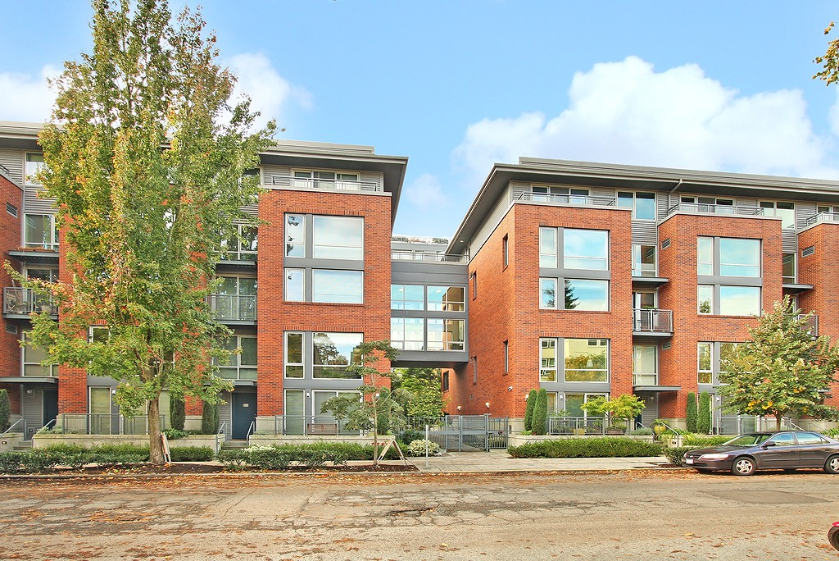
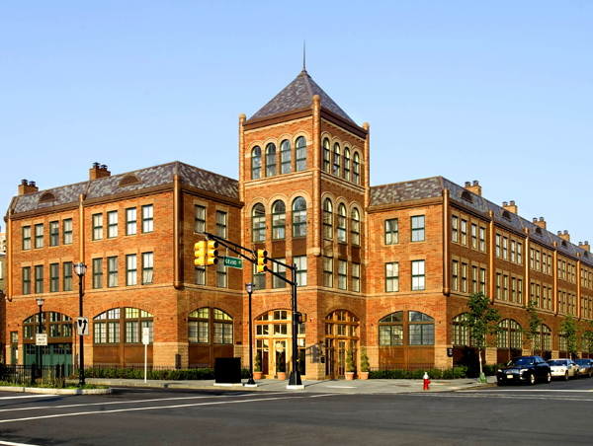
4. RFQ DETAILS
Precedents: Architecture
Eclectic, traditional style; human scale that addresses street frontages
Notes:
Expressed desire for buildings with character that will complement existing built environment of the City

Slide 18
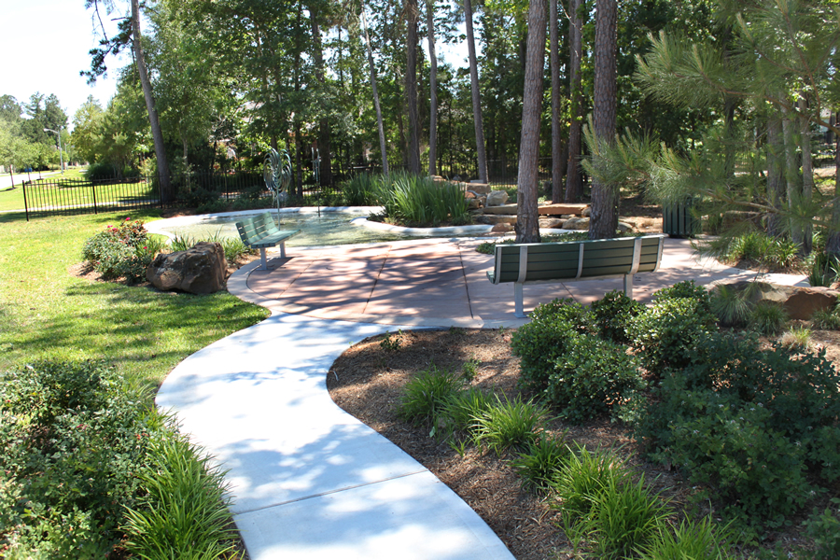
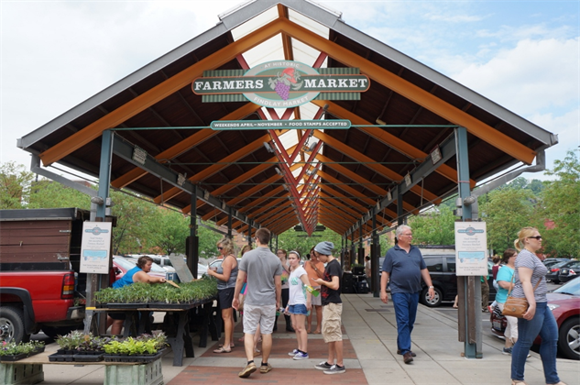
4. RFQ DETAILS
Precedents: Open Space
Deliberate, flexible, well-maintained, protected, passive, interesting landscaping
Notes:
Expressed desire for incorporation of seating into public spaces as well as opportunities for pop up markets and festivals.

Slide 19
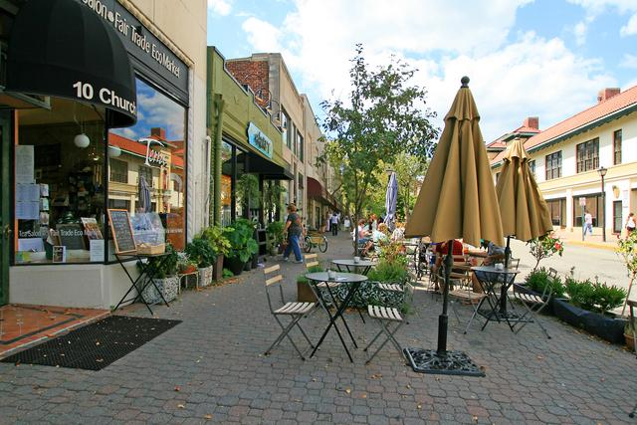
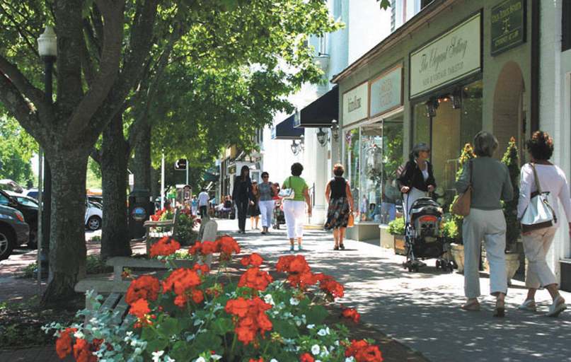
4. RFQ DETAILS
Precedents: Design
Pedestrian-friendly, programmable, green, outdoor dining, appropriate streetscaping

Slide 20
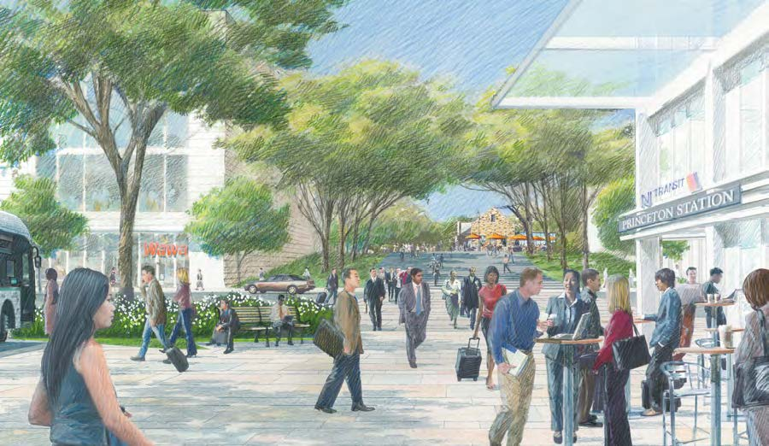
4. RFQ Details
Precedents: Circulation
People – oriented design, enhance local circulation within regional context
Notes:
Expressed desire for alleviation of traffic congestion & safety issues at intersection of Broad and Morris. Redevelopment should facilitate easier pedestrian flow between downtown, train station and Broad St West area.

Slide 21
4. RFQ DETAILS
Developer + Developer Team Selection
Established Criteria for:
Developer
Legal Team
Design Team
Construction Team
Property Manager

Slide 22
4. RFQ DETAILS
Selection Process
Step 1
Developers submit team qualifications
City interviews developers
City invites selected teams to submit more in-depth proposal

Slide 23
4. RFQ DETAILS
Selection Process
Step 2
Selected developer(s) work with City to prepare full proposal
Proposal included developer’s participation in public outreach process.
Proposals include parking/traffic studies, renderings, budget + pro forma
Final proposal incorporated into City’s Redevelopment Plan.

Slide 24
Questions?

